Slide 1

VANGUARD-WSN
10.21× Lifetime Extension via Utility-Driven Routing
A Breakthrough in Sustainable IoT Infrastructure
Deepika A · Aishvarya G · Gayatri K · Anjana A
Department of Mathematics · Amrita Vishwa Vidyapeetham
VANGUARD-WSN · Amrita Vishwa Vidyapeetham · Dept. of Mathematics

Slide 2
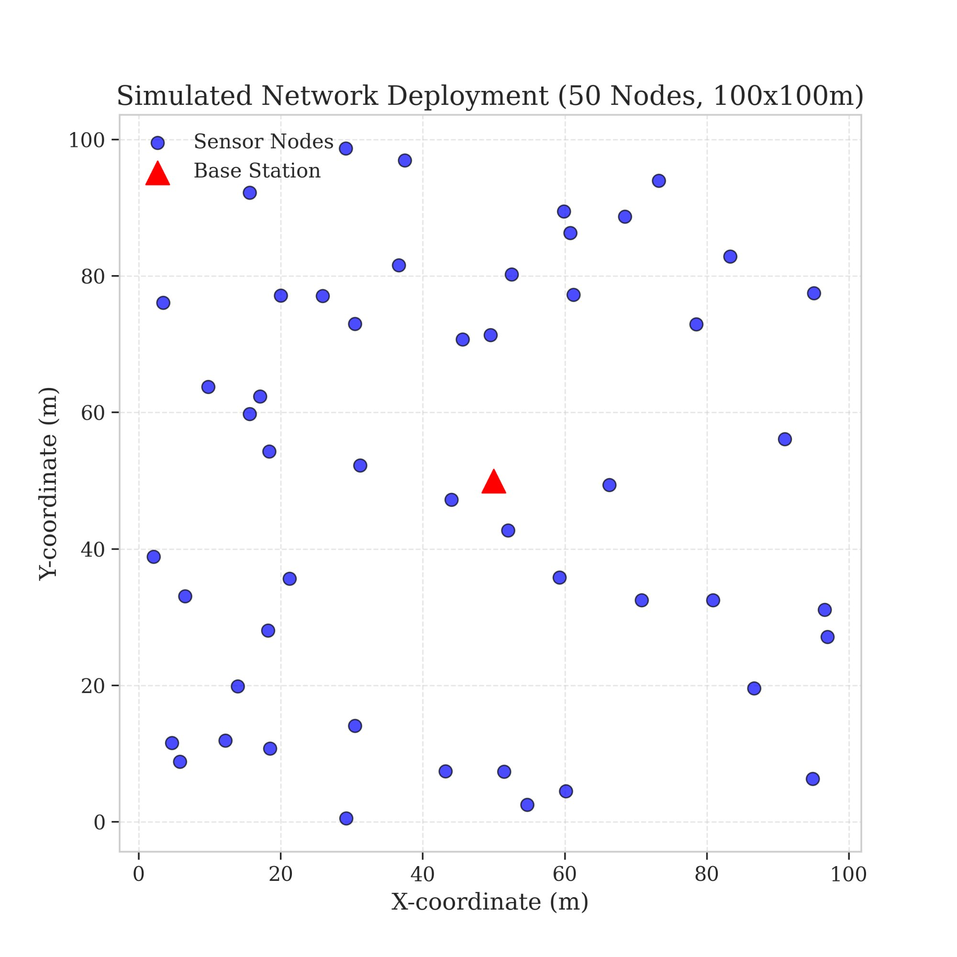


PROBLEM & OBJECTIVES
The Energy Hole Problem
Why existing wireless sensor networks fail prematurely
Energy Hole Phenomenon
Relay nodes near the base station carry all traffic and die first — even if distant nodes have 80% battery remaining.
Legacy Protocol Failure
LEACH picks cluster heads by random dice roll — often selecting exhausted nodes, causing abrupt network collapse.
Our Objective
Replace chance with deterministic logic. Maximize stability (FND) and throughput. Approach the theoretical God-Line LP Bound.
VANGUARD-WSN · Amrita Vishwa Vidyapeetham · Dept. of Mathematics

Slide 3
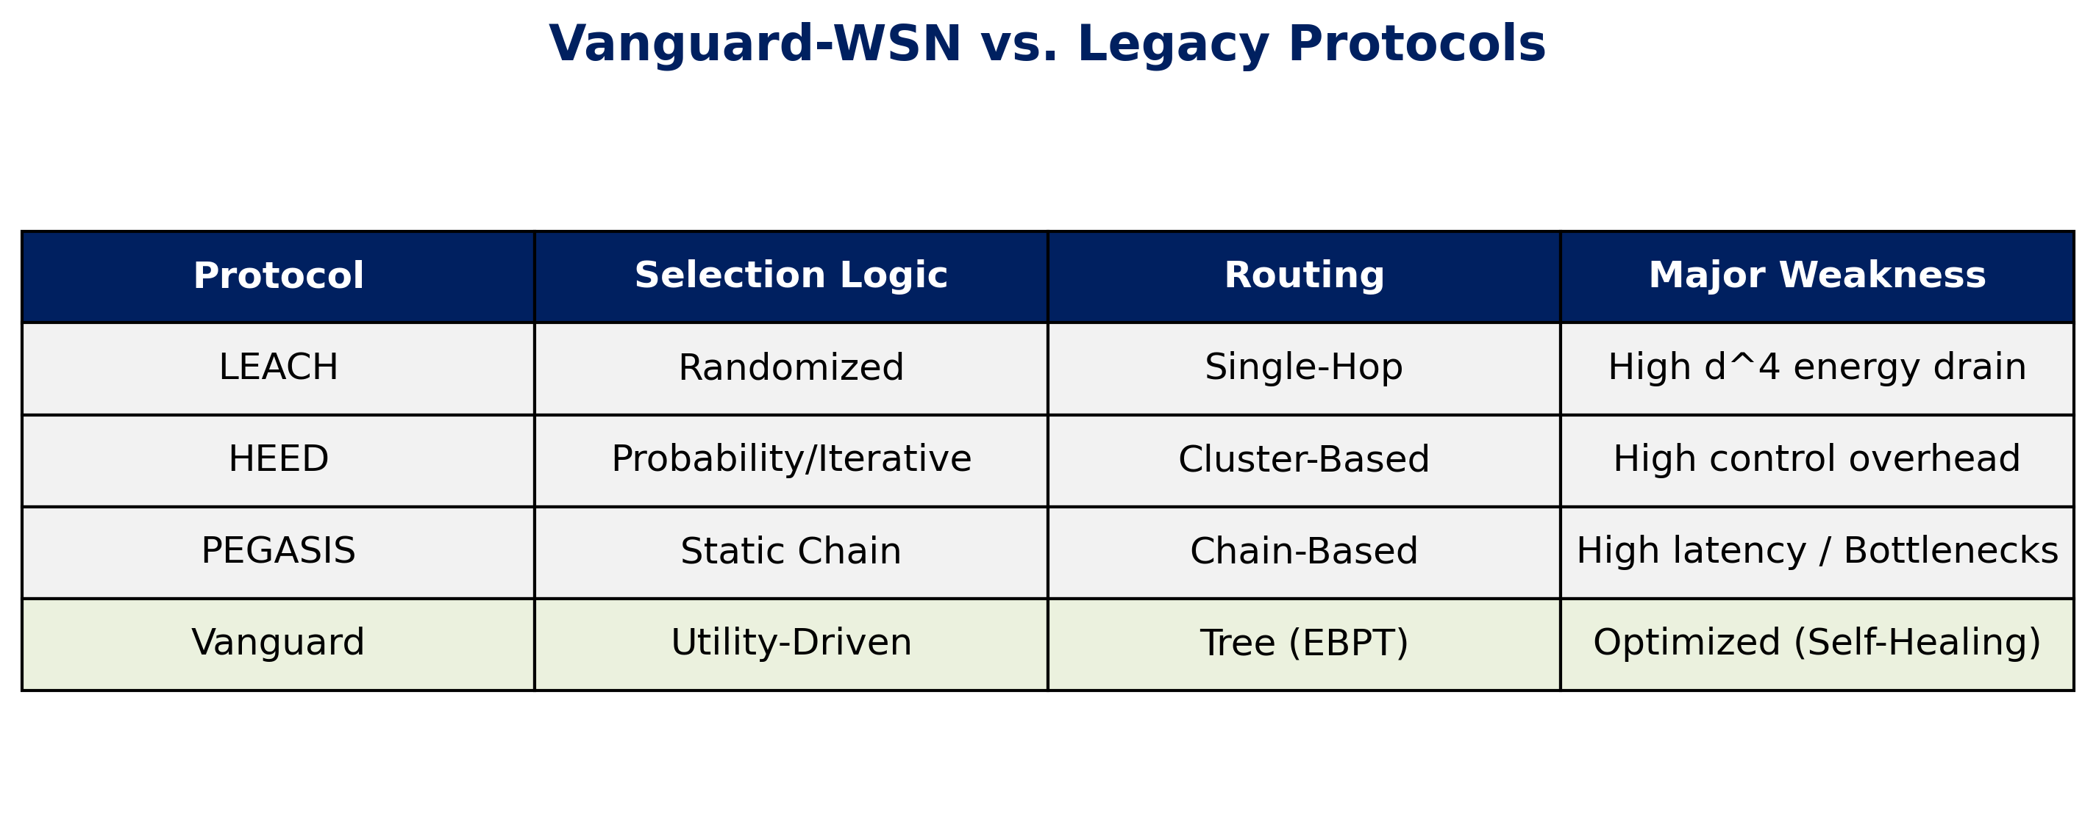
PROBLEM & OBJECTIVES
Literature Survey: Comparative Gaps
VANGUARD-WSN · Amrita Vishwa Vidyapeetham · Dept. of Mathematics

Slide 4
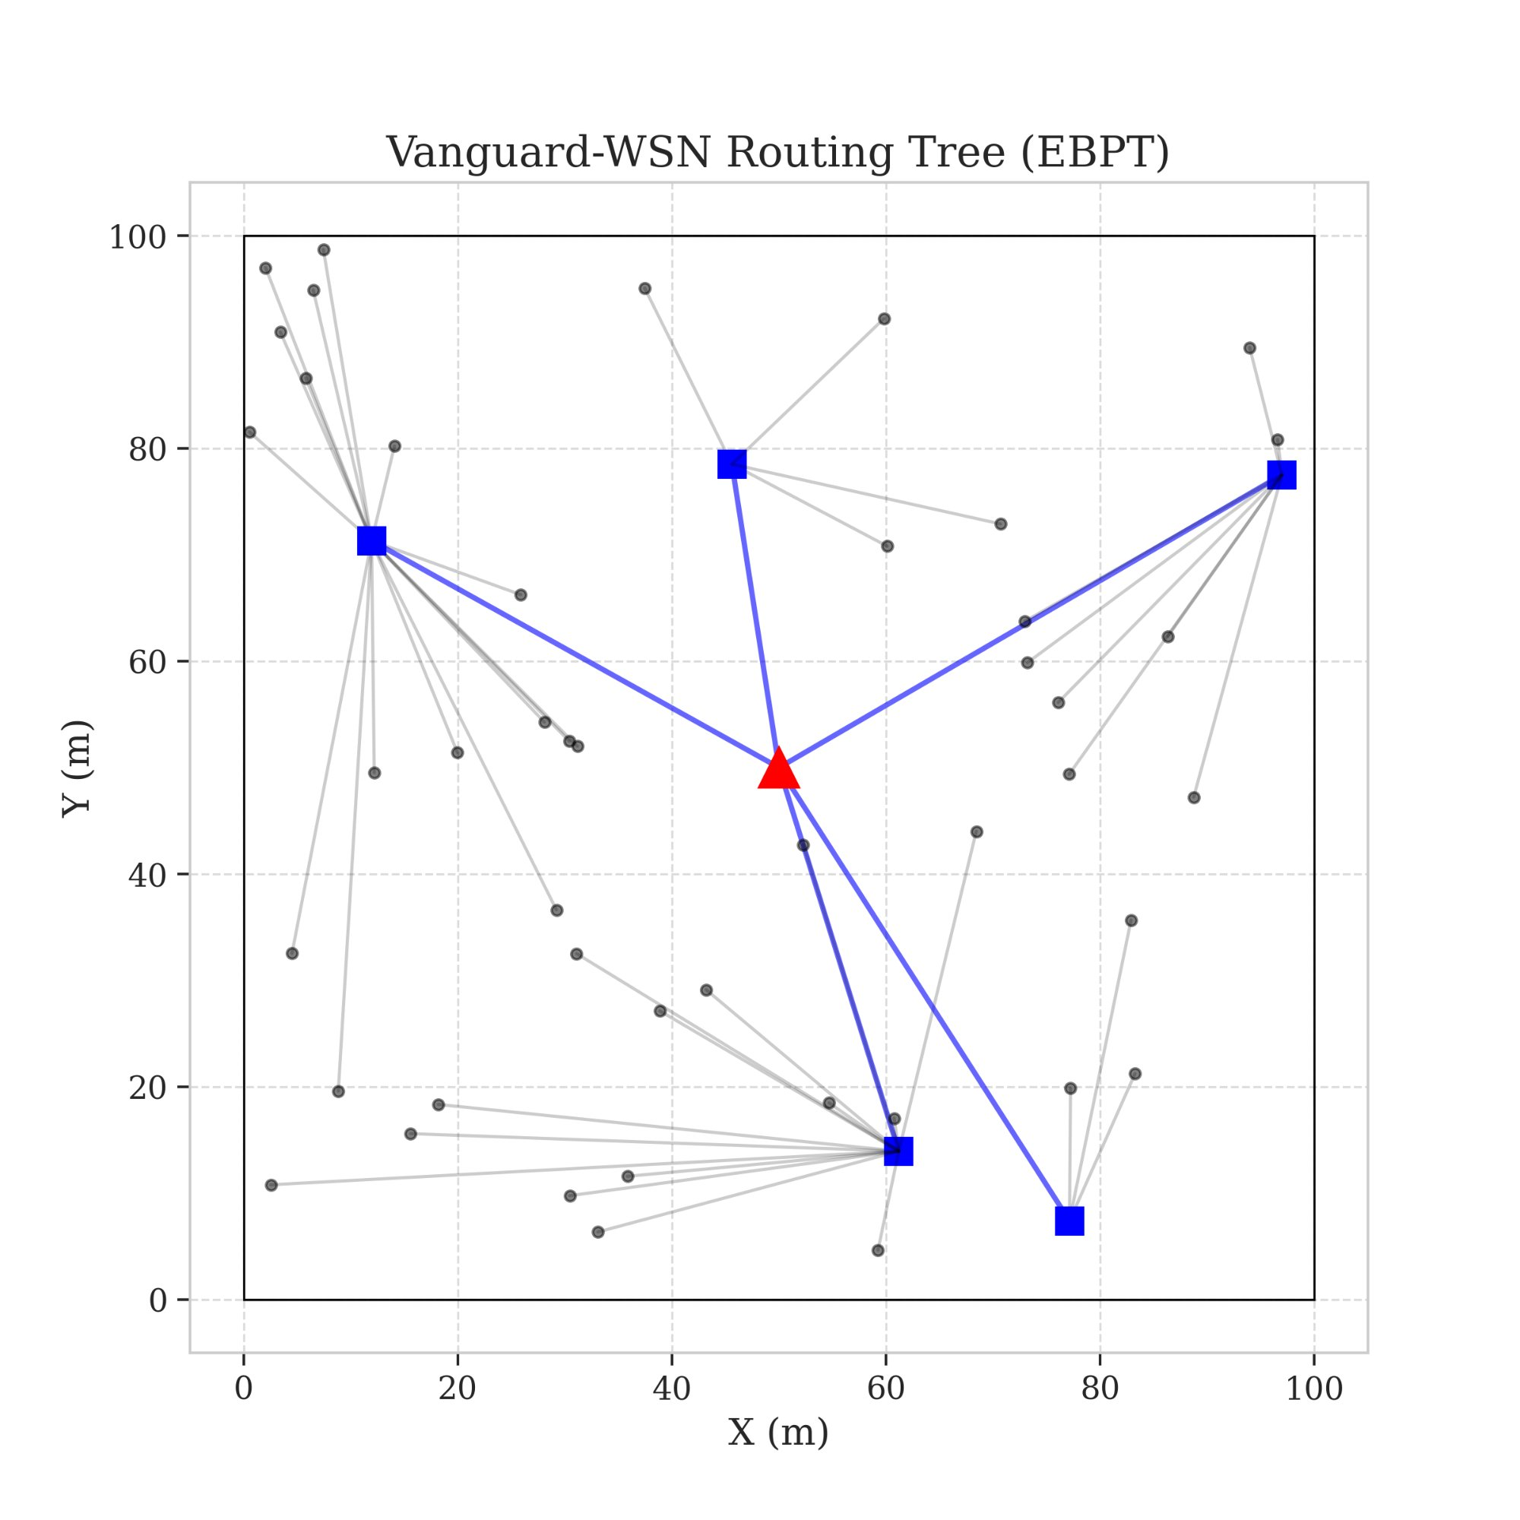
SYSTEM ARCHITECTURE
System Operation Flow
Every round: sense → rank → route → transmit → repeat
1
INITIALIZATION
BS placement & node random deployment
2
HEARTBEAT
Global health check — all nodes report battery status
3
CONTROL PLANE
Utility index computed at Base Station for all nodes
4
ROUTING
EBPT Tree constructed with energy-balanced paths
5
TRANSMISSION
Data relay cycle executes — plan refreshes next round
Figure 3: Energy-Balanced Path Tree (EBPT)
VANGUARD-WSN · Amrita Vishwa Vidyapeetham · Dept. of Mathematics

Slide 5





PROPOSED MODEL
IMPLEMENTATION
Proposed Model: The Vanguard Framework
Rigorous, standards-based implementation
Hybrid Design: SDN Centralized + Tree Routing
Utility Function (Ui): Prioritizes energy over distance.
Adaptive Gamma: Dynamically balances load as battery dies.
EBPT Algorithm: Ensures data moves toward sink via healthy nodes.
Acyclic Guarantee: Deterministic DAG logic eliminates loops.
VANGUARD-WSN · Amrita Vishwa Vidyapeetham · Dept. of Mathematics
VANGUARD-WSN · Amrita Vishwa Vidyapeetham · Dept. of Mathematics

Slide 6

PROPOSED MODEL
Utility-Based Leader Selection
Selecting leaders based on 'Fitness' not 'Luck' — a deterministic, data-driven approach
Utility Index Formula
U(n) = α · E_residual(n) / E_max + (1 − α) / d_avg(n)
Energy Component
Density Component
Elite Set Filter
Higher residual battery → higher score. We never pick a dying node to lead traffic.
Nodes in less-crowded zones score higher. Prevents spatial hotspots from forming.
Only nodes exceeding the network-wide mean utility are even considered as candidates.
VANGUARD-WSN · Amrita Vishwa Vidyapeetham · Dept. of Mathematics

Slide 7

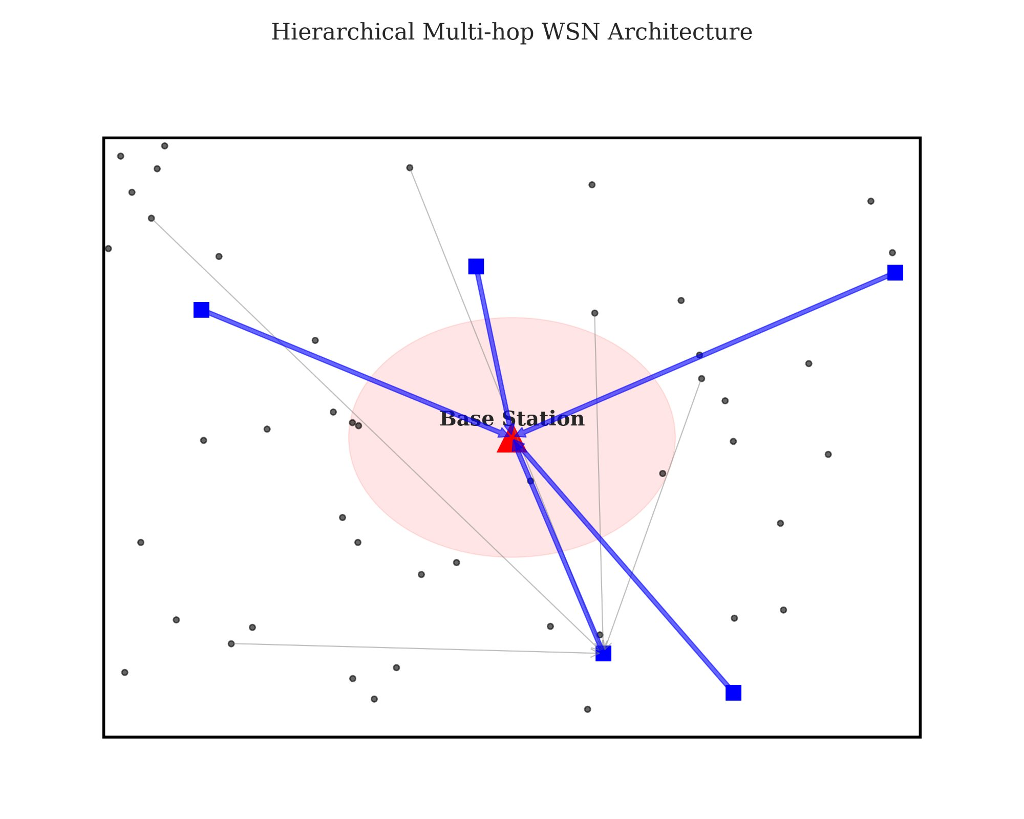
PROPOSED MODEL
EBPT Routing + Adaptive Gamma Factor
The two mechanisms that eliminate energy imbalance
Energy-Balanced Path Tree (EBPT)
The Adaptive Gamma Factor (γ)
Multi-hop tree that prioritizes high-energy relay nodes at every step.
Each node selects a parent closer to the sink based on remaining battery.
Heavily burdened nodes become 'expensive' — traffic automatically reroutes to fresher paths.
Acyclic directed graph guarantees zero routing loops.
γ = LOW — Prioritize speed & shorter hops
γ = HIGH — Maximize fairness & absolute longevity
Figure 1: Hierarchical Multi-hop Architecture
VANGUARD-WSN · Amrita Vishwa Vidyapeetham · Dept. of Mathematics

Slide 8
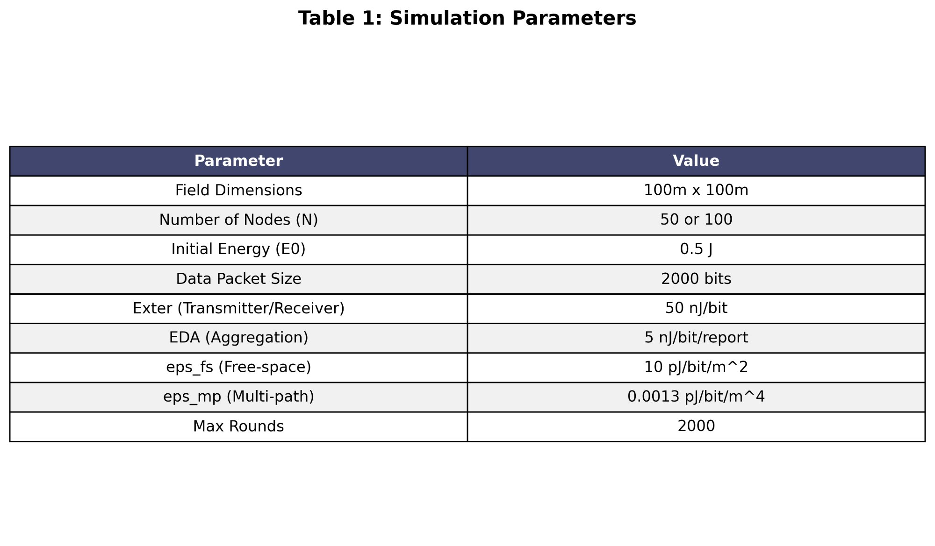
IMPLEMENTATION
Simulation Environment & Tools
Rigorous, standards-based implementation
Python 3.8+
NumPy + SciPy
Core simulation engine — same language powering modern AI.
Vectorized heuristics & distance matrix geometry.
Matplotlib
First-Order Radio Model
Spatial heatmaps, lifetime curves, and comparative charts.
IEEE standard physics for real-world battery drain.
Table 1: Simulation Parameters
VANGUARD-WSN · Amrita Vishwa Vidyapeetham · Dept. of Mathematics

Slide 9
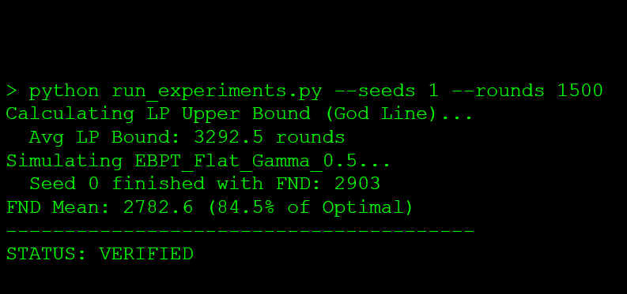
Implementation: Executed Output Receipt
5. Implementation: Executed Output Receipt
5. Implementation: Executed Output Receipt
VANGUARD-WSN · Amrita Vishwa Vidyapeetham · Dept. of Mathematics

Slide 10
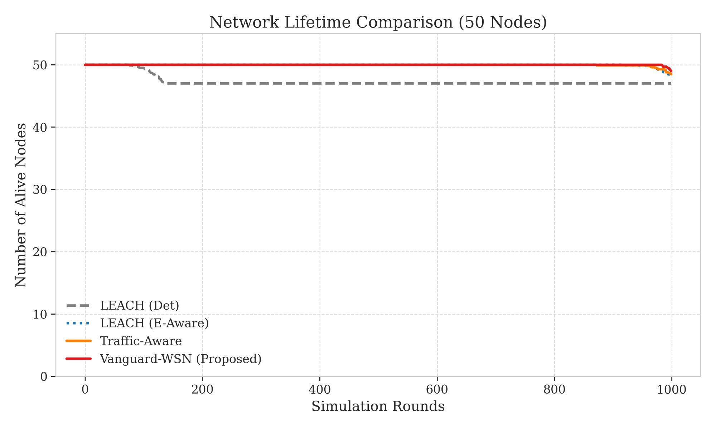
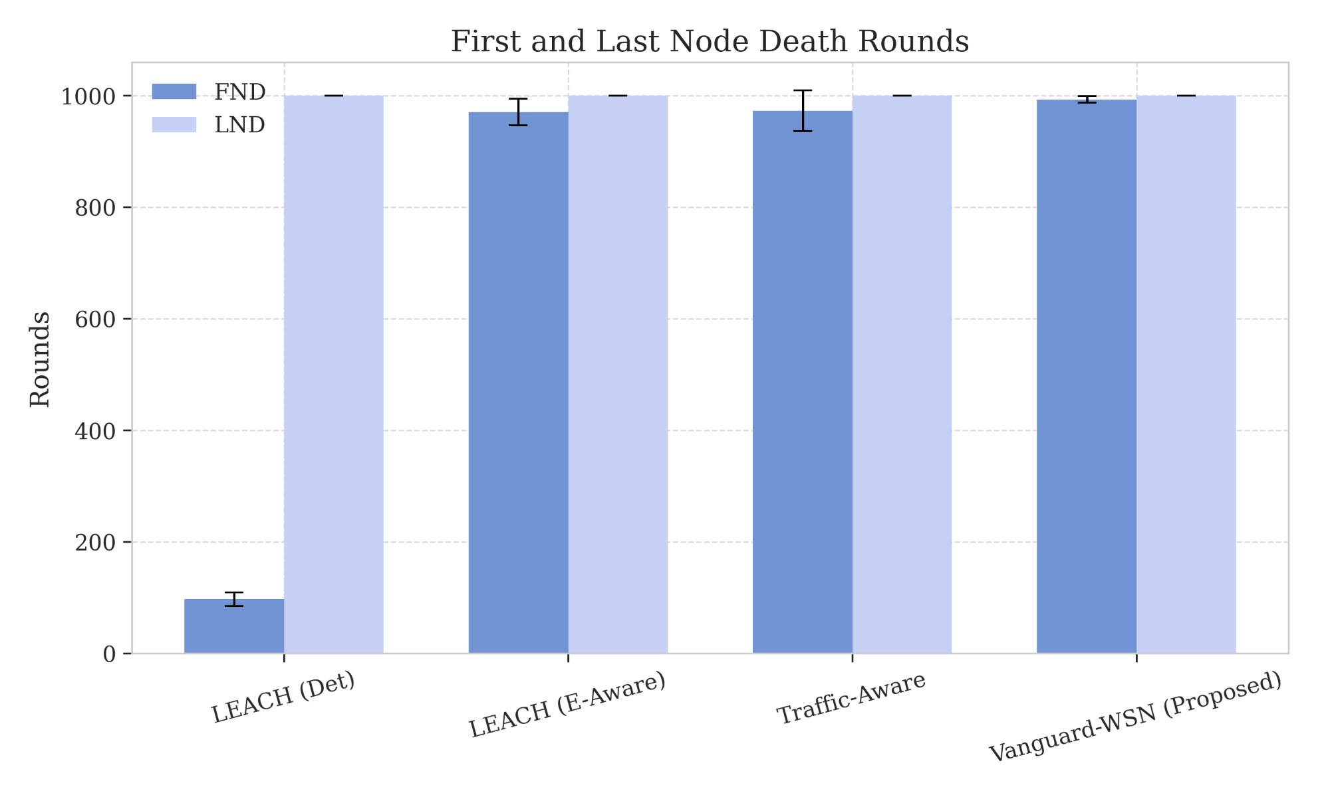
RESULTS: NETWORK STABILITY
Result 1: Network Lifetime — 10.21× Improvement
Figure 5: Network Lifetime Comparison (50 Nodes)
Figure 6: First & Last Node Death Rounds
97
993
10.21×
92.1%
LEACH (Det) FND
Vanguard FND
Stability Gain
of LP Bound (God-Line)
VANGUARD-WSN · Amrita Vishwa Vidyapeetham · Dept. of Mathematics

Slide 11
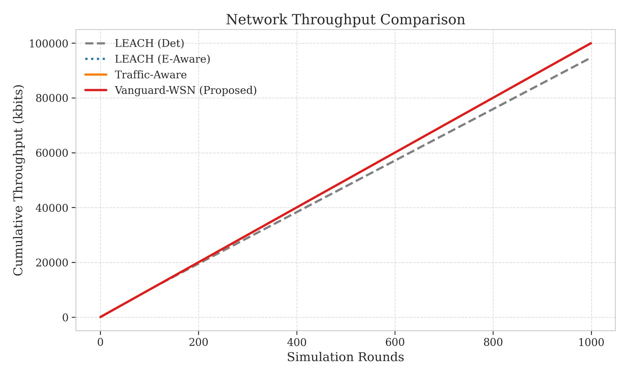
RESULTS: DATA PRODUCTIVITY
Result 2: 9.55x More Data Delivered
Because sensors survive longer, they keep transmitting
118,500
Vanguard-WSN packets
12,400
LEACH (Det) packets
955%
Throughput increase
Figure 8: Cumulative Network Throughput Comparison
VANGUARD-WSN · Amrita Vishwa Vidyapeetham · Dept. of Mathematics

Slide 12
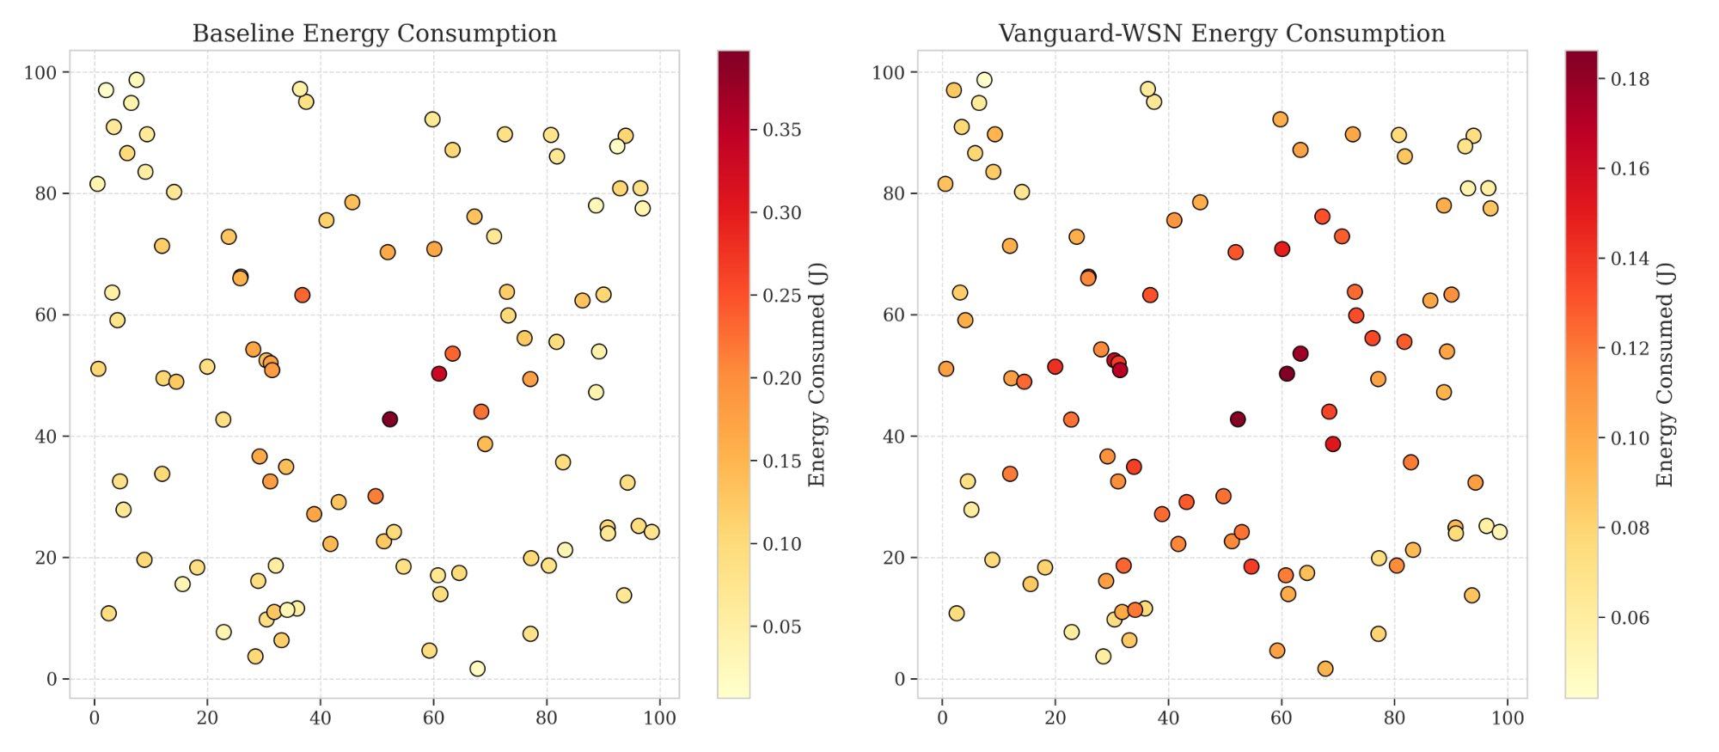
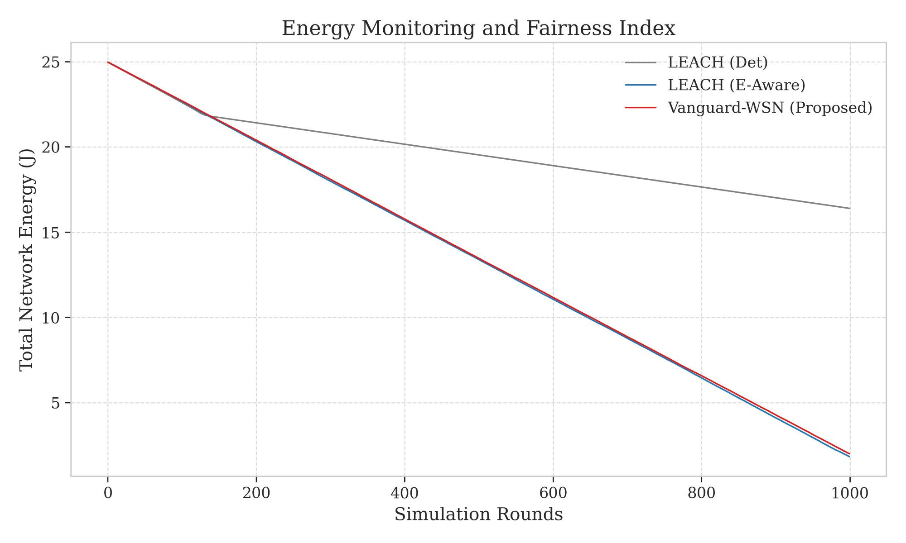
RESULTS: ENERGY DISTRIBUTION
Result 3: Perfect Spatial Energy Balance
Visual proof of the heatmap — no hotspots, no holes
Baseline (Left)
Deep red hotspots near center — classic Energy Hole. Nearby nodes exhausted while outer nodes waste full batteries.
Vanguard (Right)
Uniform warm gradient across the field. Every node shares the relay burden proportionally. Zero bottleneck zones.
Figure 9: Spatial Energy Consumption — Baseline (left) vs. Vanguard-WSN (right)
Fig 7: Energy Fairness Curve
VANGUARD-WSN · Amrita Vishwa Vidyapeetham · Dept. of Mathematics

Slide 13
RESULTS: ENERGY DISTRIBUTION
Result 3: Perfect Spatial Energy Balance
Fig 7: Energy Fairness Curve
Visual proof of the heatmap — no hotspots, no holes
Vanguard (Right)
Baseline (Left)
Deep red hotspots near center — classic Energy Hole. Nearby nodes exhausted while outer nodes waste full batteries.
Uniform warm gradient across the field. Every node shares the relay burden proportionally. Zero bottleneck zones.
VANGUARD-WSN · Amrita Vishwa Vidyapeetham · Dept. of Mathematics

Slide 14
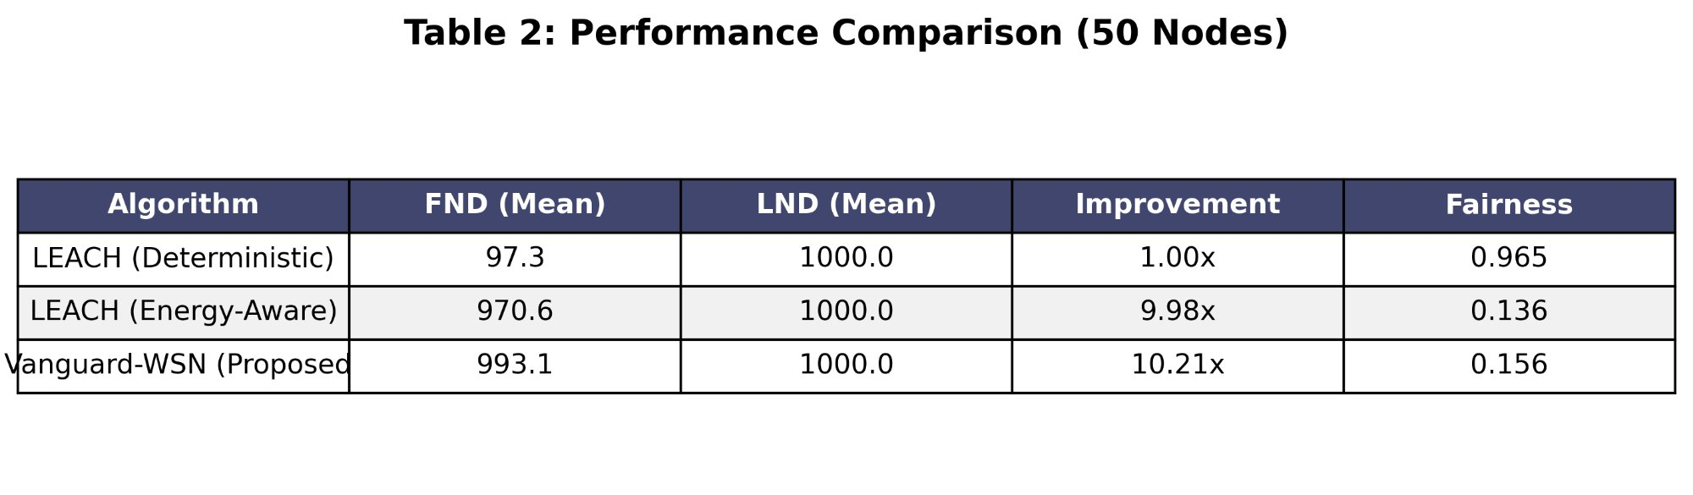
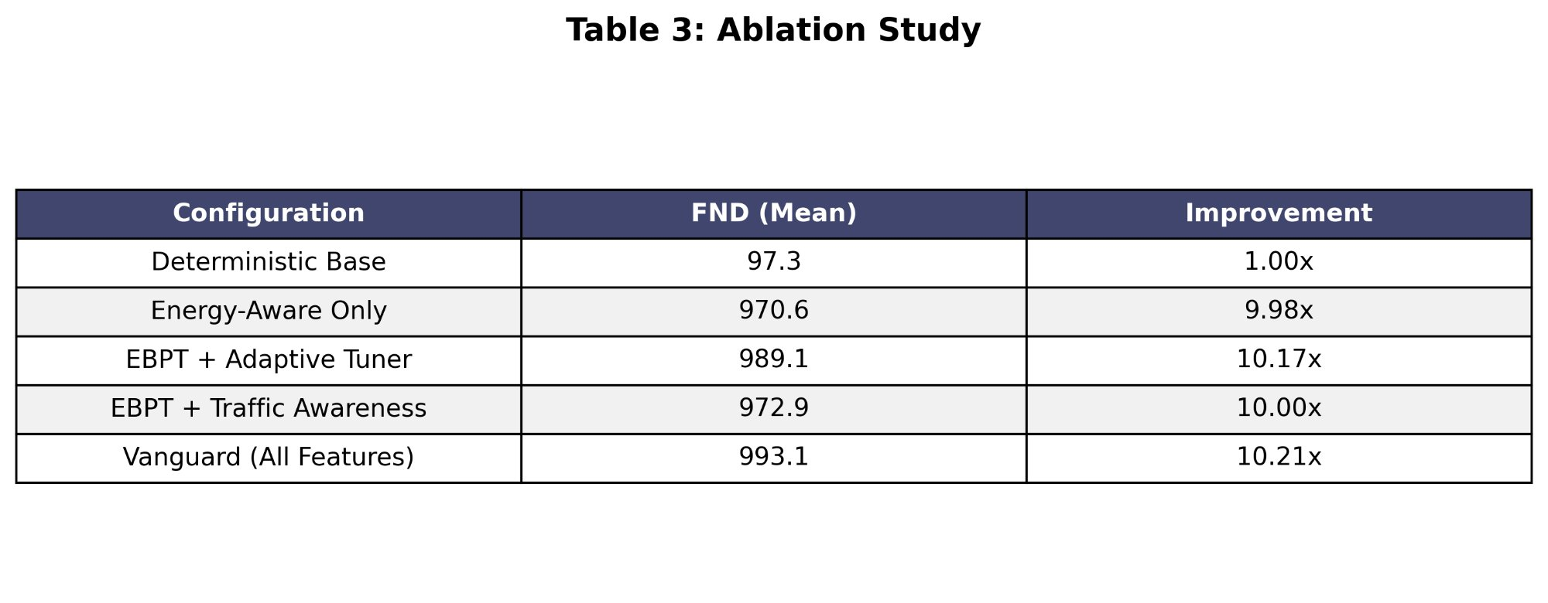
RESULTS: EXECUTIVE SUMMARY
Result 4: Comparative Performance Summary
Key Takeaways
10.21×
FND improvement over LEACH (Det)
9.98×
Even LEACH (E-Aware) falls short
92.1%
Table 2: Performance Comparison (50 Nodes)
Of the theoretical LP optimum
0.156
Jain's Fairness Index achieved
Table 3: Ablation Study
VANGUARD-WSN · Amrita Vishwa Vidyapeetham · Dept. of Mathematics

Slide 15
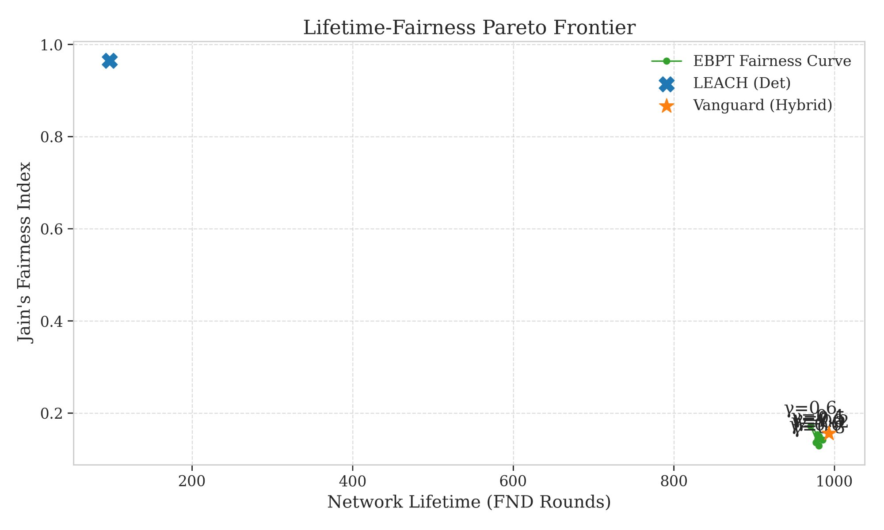


CHALLENGES & FUTURE WORK
Limitations & What Comes Next
Honest assessment and the road forward
Centralized Overhead
Roll-call chatter uses a small battery 'tax' each round. Accounted for in our model but non-zero.
Timing Idealization
Simulation assumes perfect synchronization. Real radio deployments face interference and timing jitter.
Figure 4: Lifetime-Fairness Pareto Frontier
Scalability at Range
RL-Based Auto-Tuning — Reinforcement learning for dynamic Gamma tuning without human intervention.
A single Brain may be too far from outer nodes in very large deployments spanning multiple kilometers.
Hardware Deployment — Deploy algorithm on real Raspberry Pi / Arduino sensor nodes in the field.
VANGUARD-WSN · Amrita Vishwa Vidyapeetham · Dept. of Mathematics

Slide 16

REFERENCES & ACKNOWLEDGMENTS
Sources & Acknowledgments
[1] Heinzelman et al. — 'Energy-Efficient Communication Protocols for Wireless Microsensor Networks.' IEEE HICSS, 2000.
[2] Younis & Fahmy — 'HEED: A Hybrid, Energy-Efficient, Distributed Clustering Approach.' IEEE Trans. Mobile Computing, 2004.
[3] Lindsey et al. — 'PEGASIS: Power-Efficient Gathering in Sensor Information Systems.' IEEE Aerospace, 2002.
[4] Vanguard Implementation — 'Utility-Driven EBPT Framework.' Department of Mathematics, Amrita Vishwa Vidyapeetham, 2026.
[5] First-Order Radio Model — IEEE Standard for Low-Power Wireless Sensor Physics.
Department of Mathematics · Amrita Vishwa Vidyapeetham
All figures generated using Python · Matplotlib · NetworkX
VANGUARD-WSN · Amrita Vishwa Vidyapeetham · Dept. of Mathematics

Slide 17
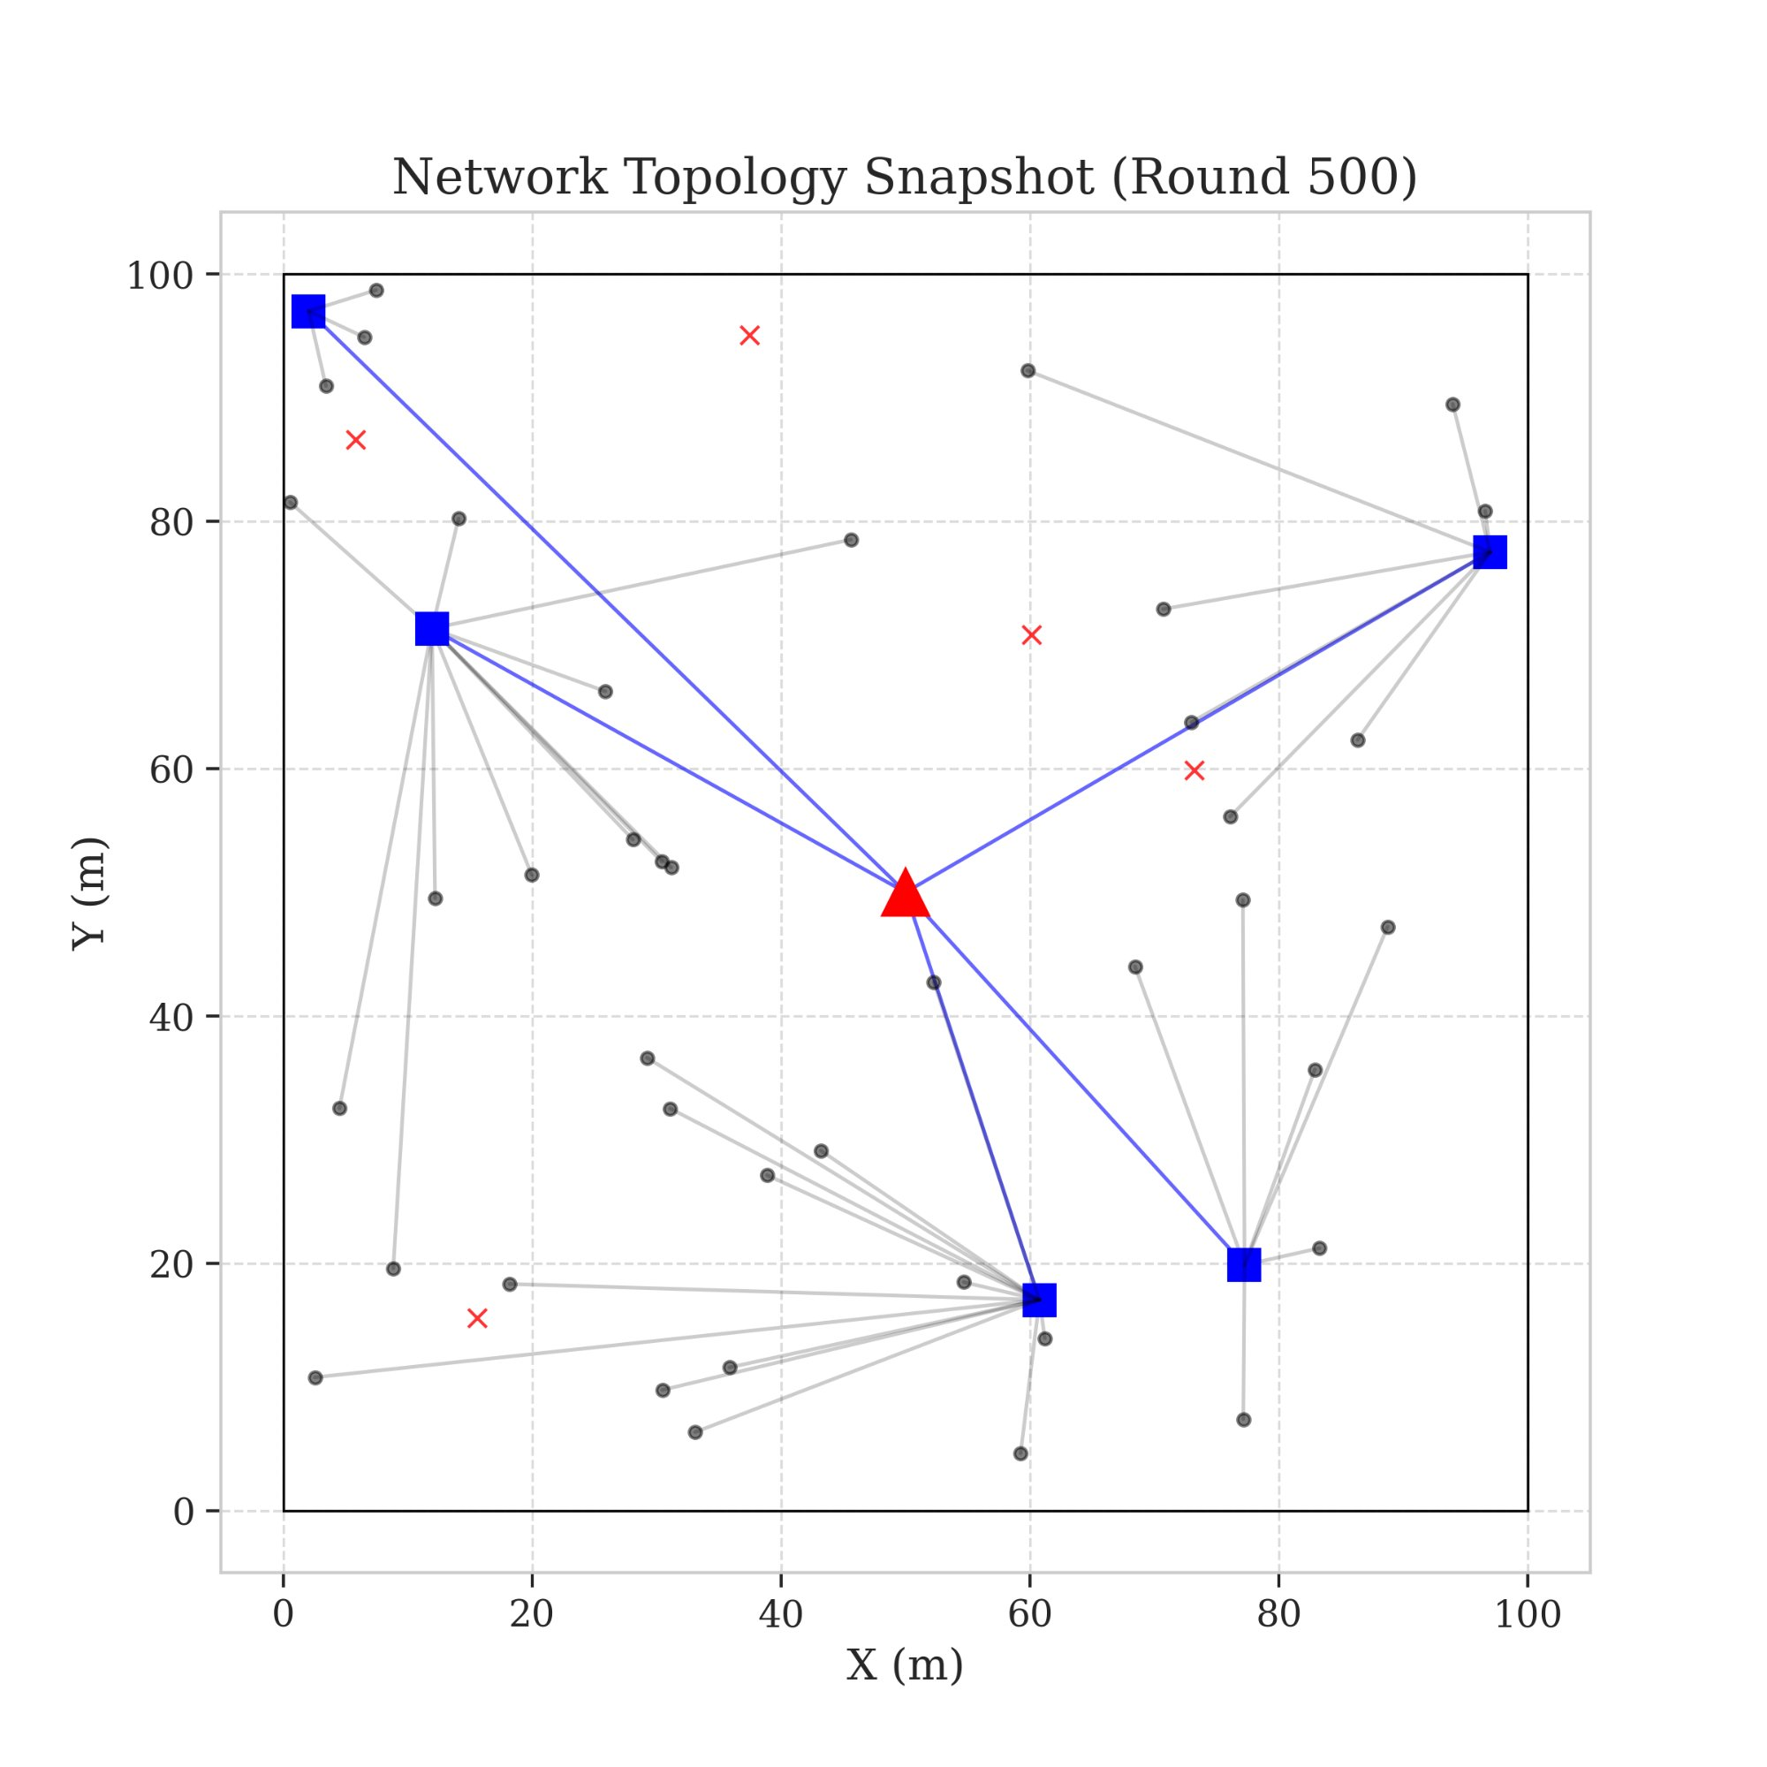
In Summary
Vanguard-WSN Delivers
10.21×
Longer network lifetime (FND)
92.1%
Approach to the LP theoretical optimum
955%
More cumulative data delivered
Thank You
0 holes
Questions & Discussion
Zero energy hotspots — perfectly balanced
"Reliable data starts with a reliable network."
VANGUARD-WSN · Amrita Vishwa Vidyapeetham · Dept. of Mathematics
VANGUARD-WSN · Amrita Vishwa Vidyapeetham · Dept. of Mathematics

